Slide 1
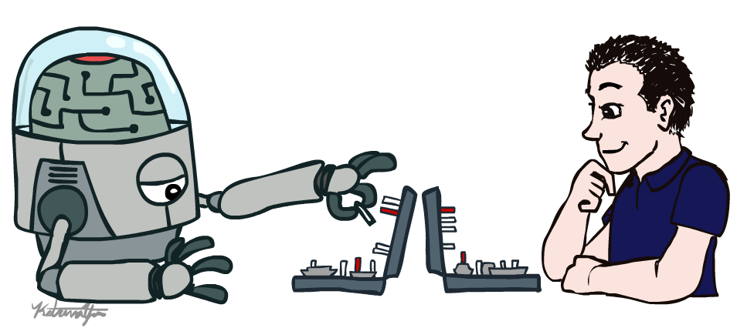
CS 632: Artificial Intelligence
Introduction
Instructor: Dr. Muhammad Aqib
University Institute of Information Technology
PMAS-Arid Agriculture University Rawalpindi
(slides courtesy Dan Klein, Pieter Abbeel, University of California, Berkeley)

Slide 2
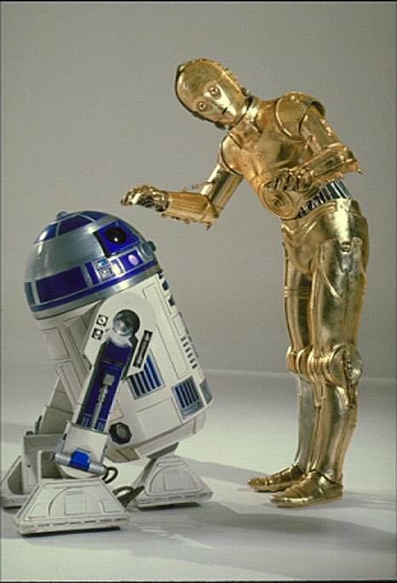
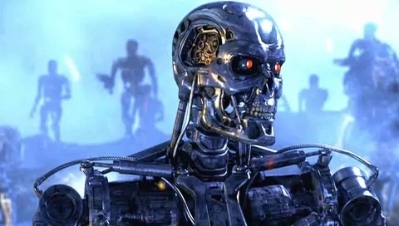
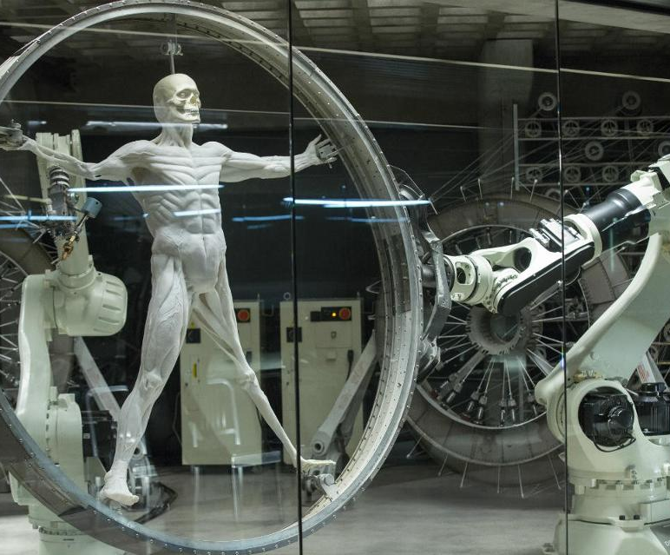
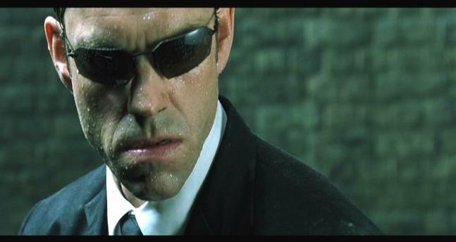

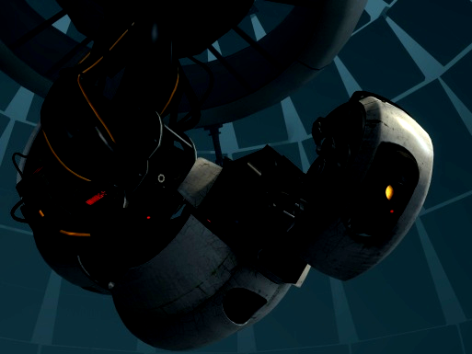
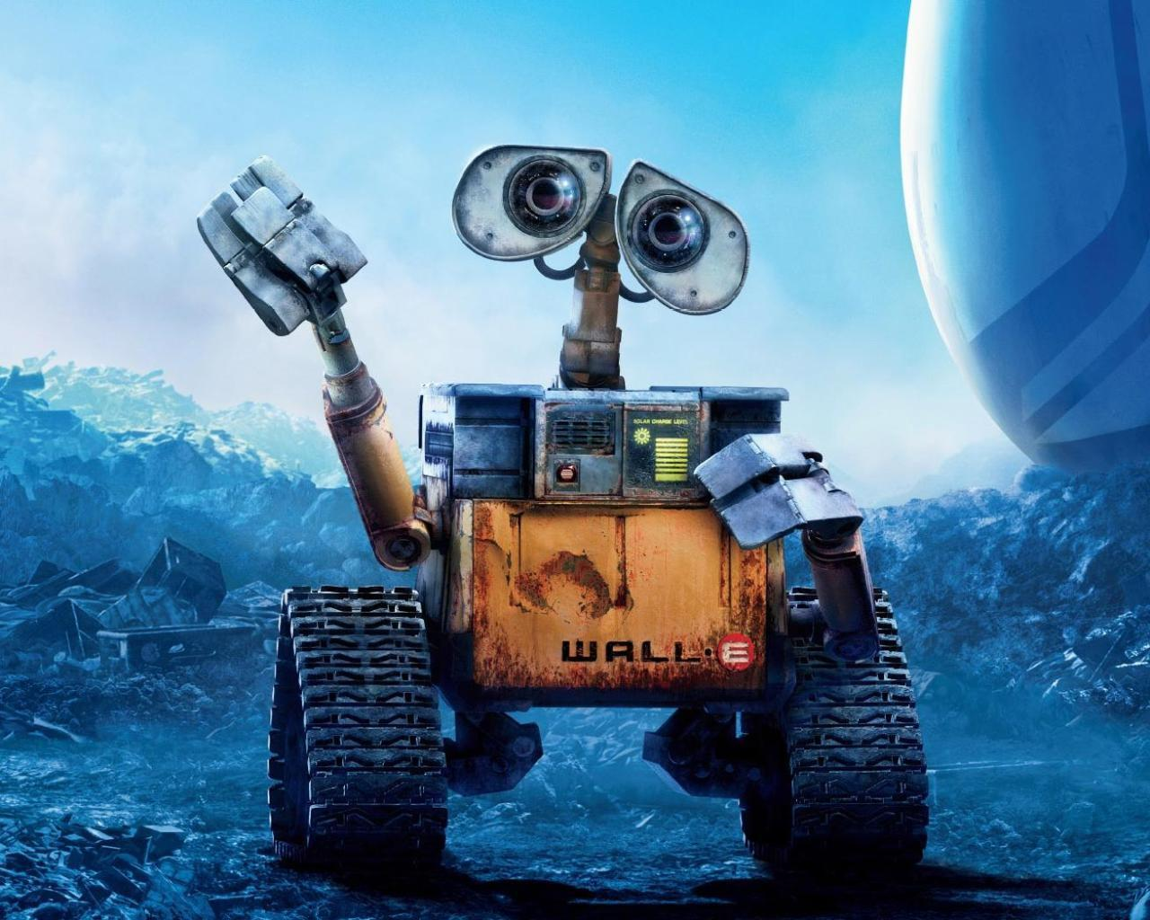
AI
Notes:
Who are these? C3PO, what does he do? Essentially google translate, (but with anxiety!)
Little guy? R2D2 – what does he do, yeah, not so sure
Things got darker: machines come back from the future – to kill us!
90’s : software is scary
Basic fear about what technology might do ?
What if we can’t even tell technology apart from ourselves?
OR maybe it’ll look really different and snarky
Some exceptions like wall-E, positive view of technology (but maybe not of us humans!)
But mostly a worry
[not very worried myself, at least at present]

Slide 3
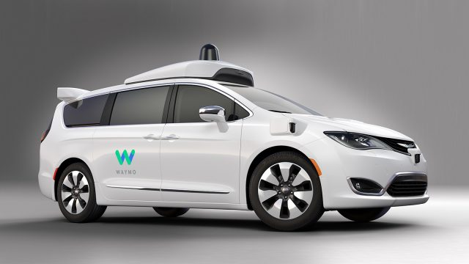
Notes:
Robots look like this. We have autonomous cars that figure out how to take us to our destination

Slide 4
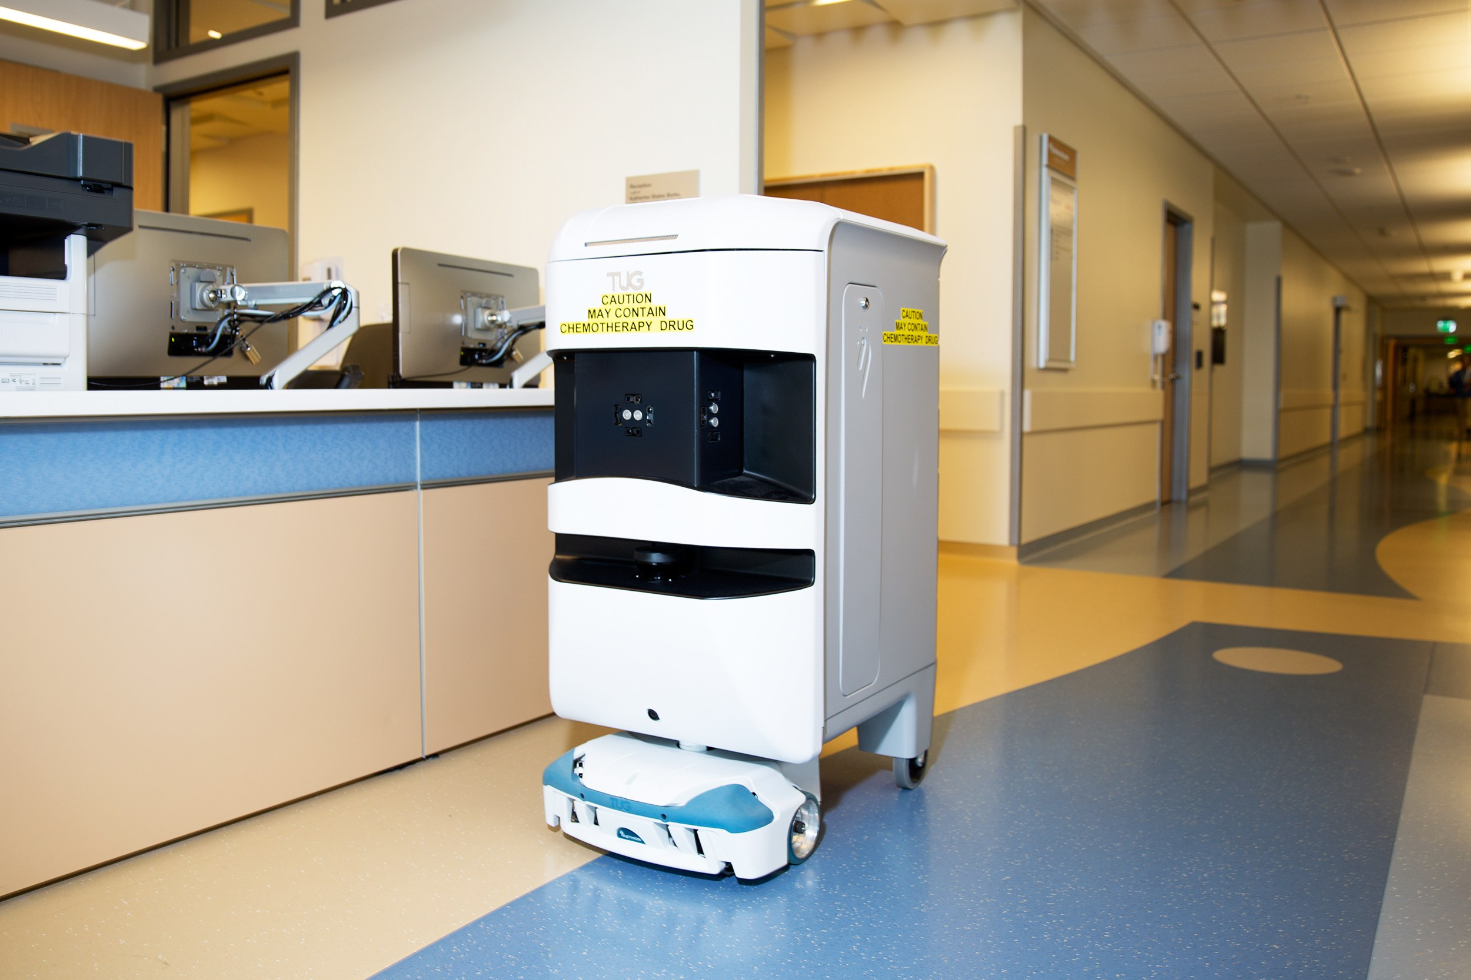
Notes:
Robots help nurses in hospitals deliver stuff to different rooms

Slide 5
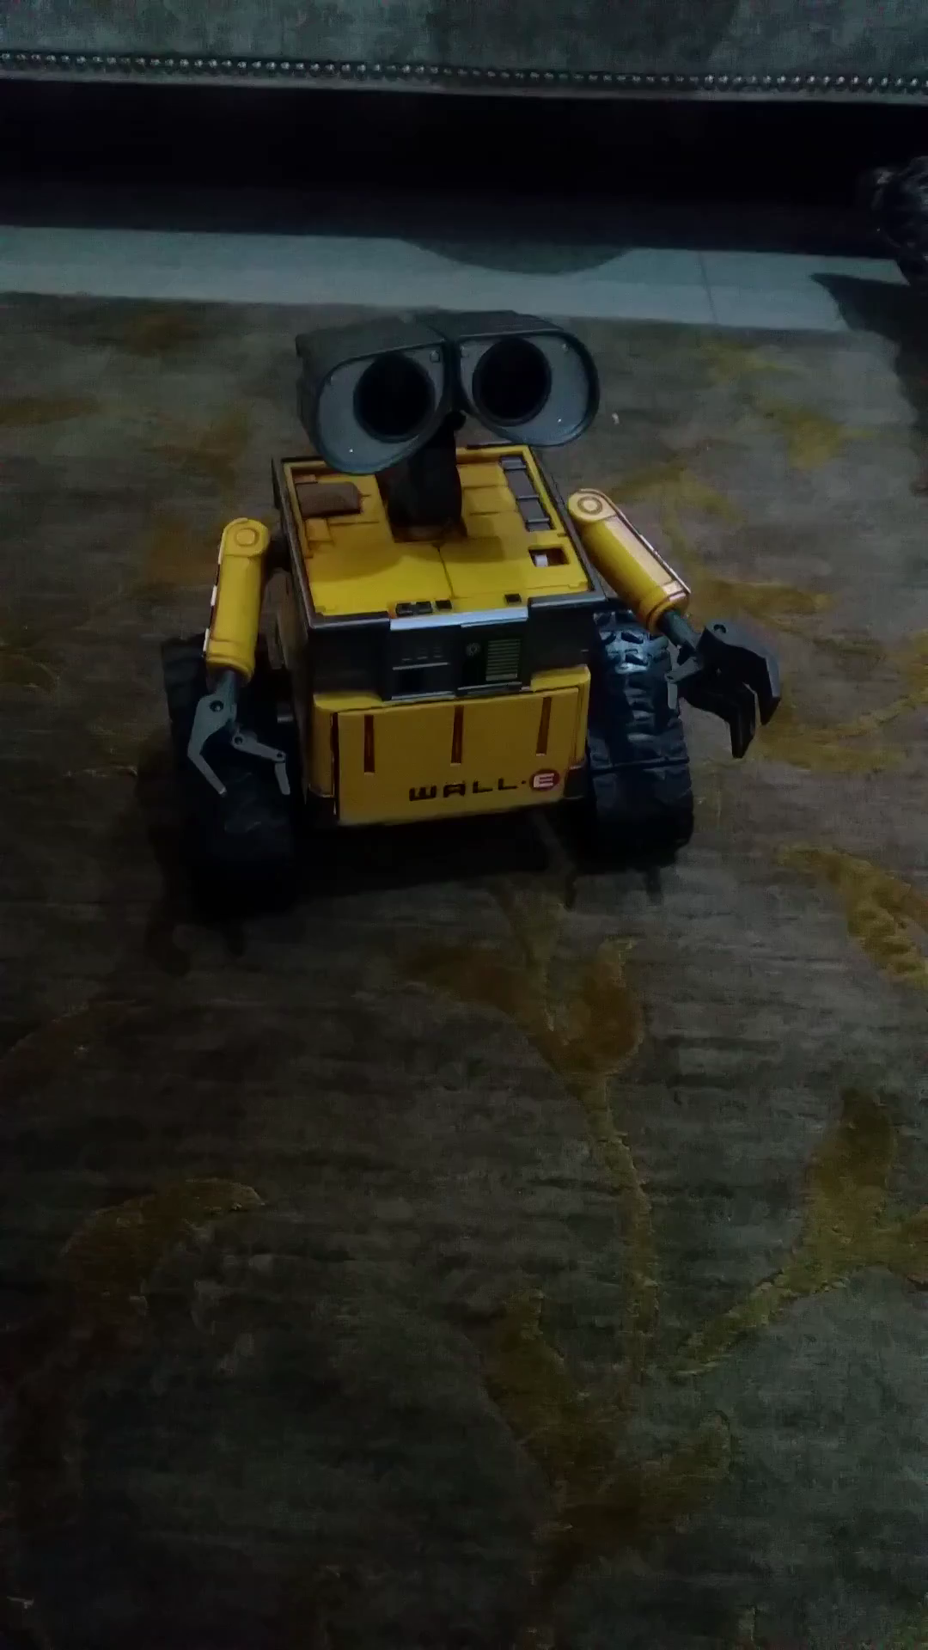
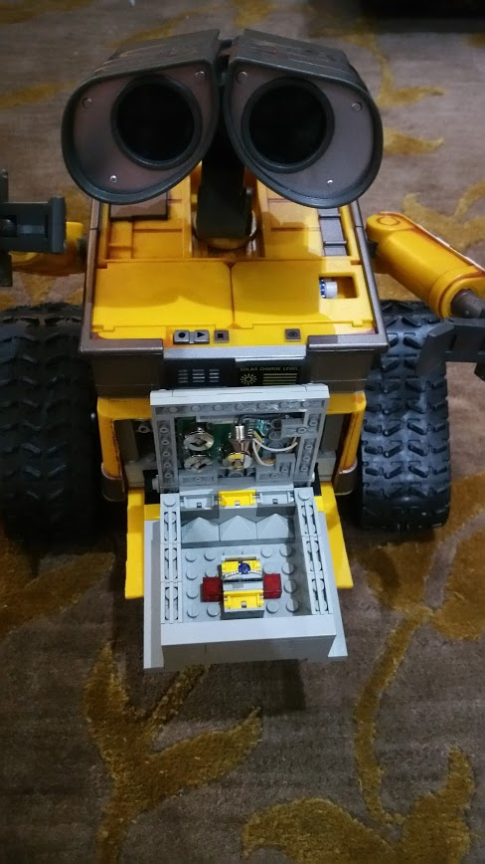
AI
Notes:
Wall-E

Slide 6
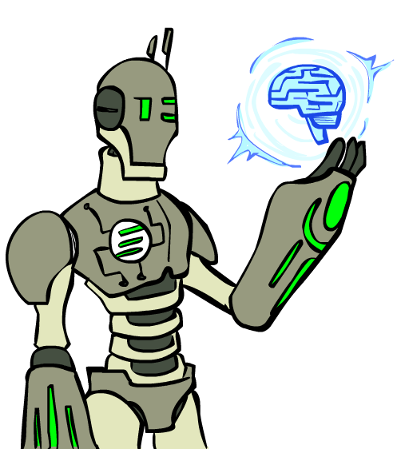
Today
What is artificial intelligence?
Where did it come from/What can AI do?
What should we and shouldn’t we worry about? What can we do about the things we should worry about?
What is this course?

Slide 7
This lecture:
What is it / what are the basics of how it works?
What are things we should and should not worry about?
How might we fix the things we should worry about?

Slide 8
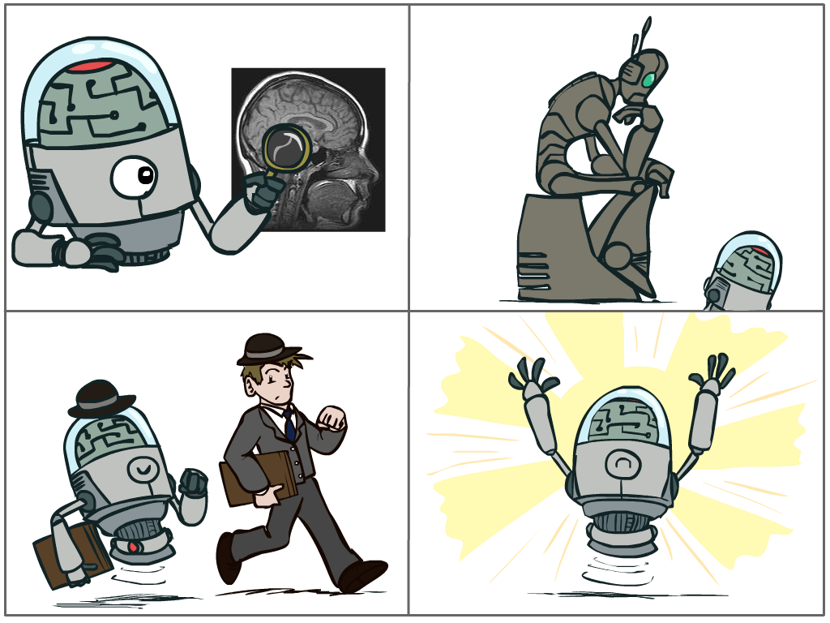
What is AI?
The science of making machines that:
Think like people
Think rationally
Act like people
Act rationally
Notes:
Top left: natural intelligence -- Think like people --- cognitive science, neuroscience
Bottom left: who cares about how they think? act like people --- actually very early definition, dating back to Alan Turing --- Turing test; problem to do really well you start focusing on things like don’t answer too quickly what the square root of 1412 is, don’t spell too well, and make sure you have a favorite movie etc. So it wasn’t really leading us to build intelligence
Think rationally – correct thought process -- long tradition dating back to Aristotle --- this is how to think so that you don’t make mistakes; but not a winner, because difficult to encode how to think / especially in the face of unknowns/uncertainty, and in the end it’s not about how you think, it’s about how you end up acting

Slide 9
Rational Decisions
We’ll use the term rational in a very specific, technical way:
Rational: maximally achieving pre-defined goals
Rationality only concerns what decisions are made
(not the thought process behind them)
Goals are expressed in terms of the utility of outcomes
Being rational means maximizing your expected utility
Notes:
Not about building machines that don’t get angry
Example of utilities. 10 for A, 1 for each Friday with friends

Slide 10
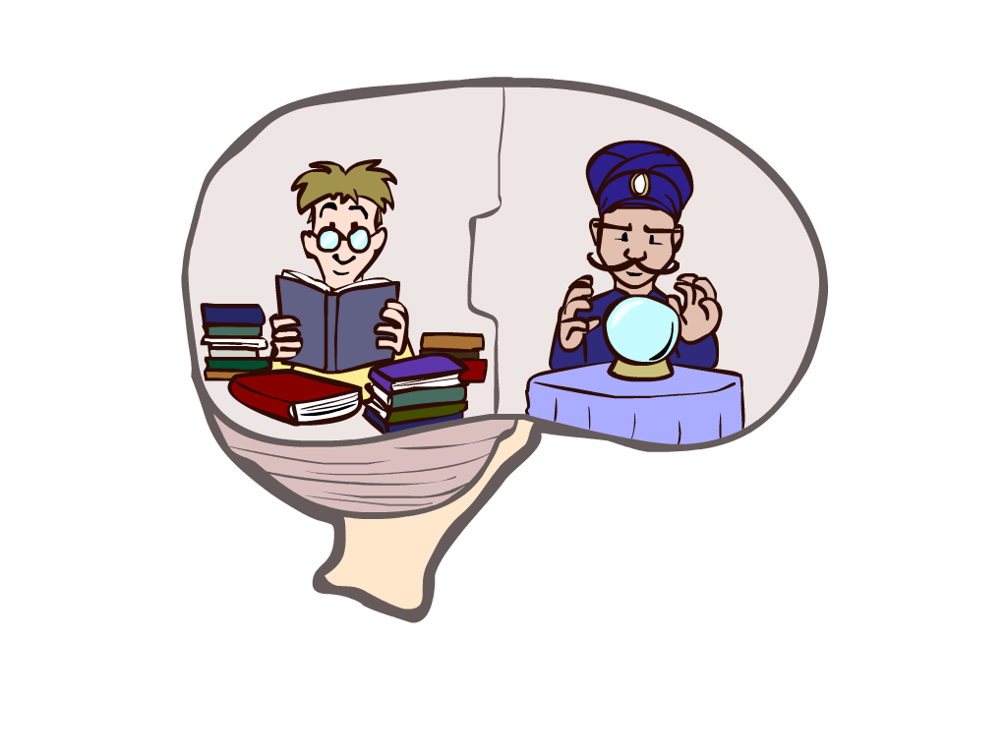
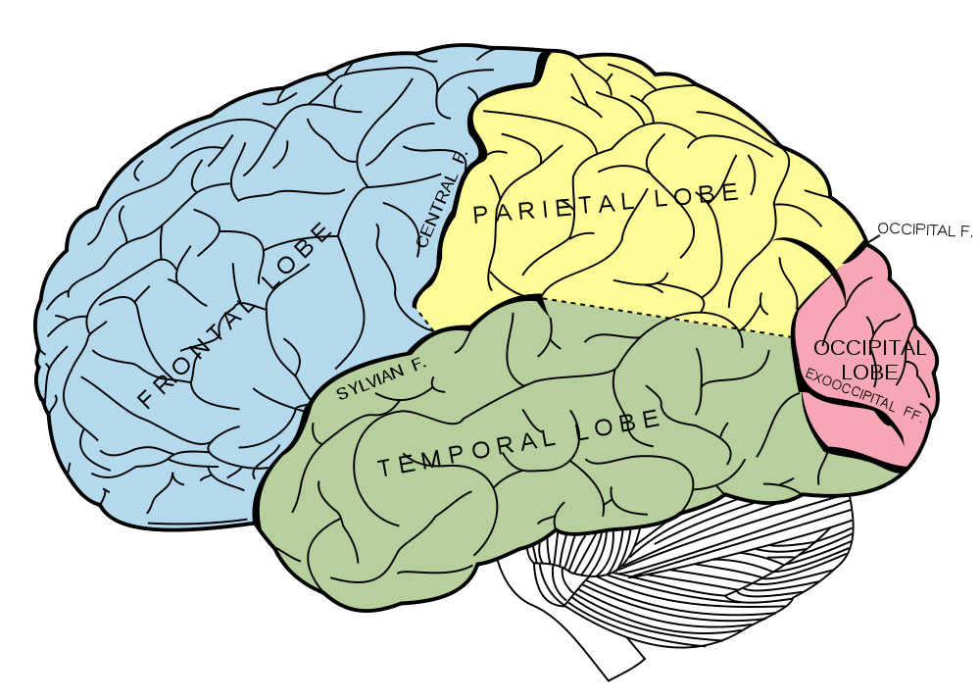
What About the Brain?
Brains (human minds) are very good at making rational decisions, but not perfect
Brains aren’t as modular as software, so hard to reverse engineer!
“Brains are to intelligence as wings are to flight”
Lessons learned from the brain: memory and simulation are key to decision making
Notes:
Stopped making wings that flap

Slide 11
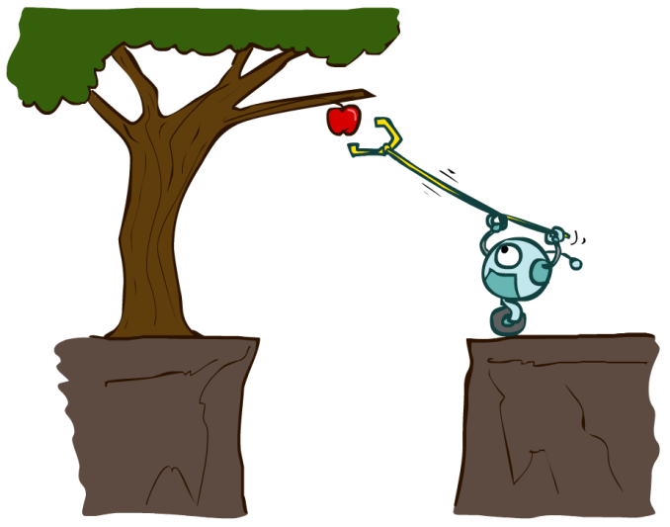
Designing Rational Agents
An agent is an entity that perceives and acts.
A rational agent selects actions that maximize its (expected) utility.
Characteristics of the percepts, environment, and action space dictate techniques for selecting rational actions
This course is about:
General AI techniques for a variety of problem types
Learning to recognize when and how a new problem can be solved with an existing technique
Sensors
Agent
Percepts
Environment
?
Actuators
Actions

Slide 12


Slide 13
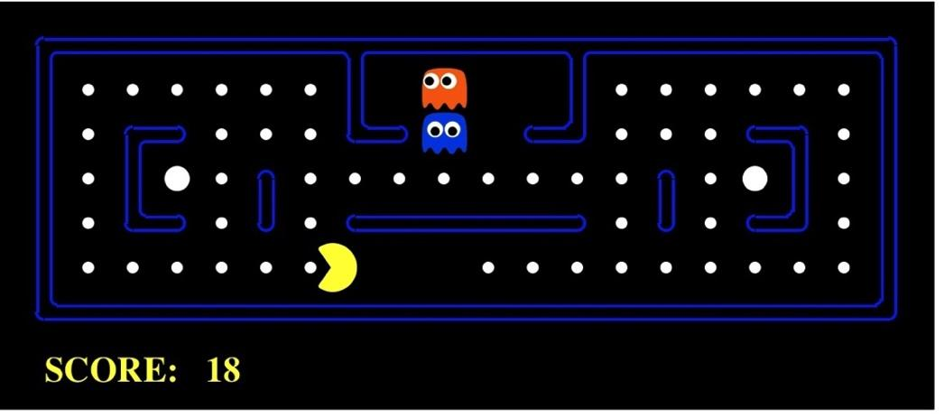
Course Format
Projects
Python
Give you hands-on experience with the algorithms
I expect you to get 100% on projects

Slide 14
Course Format (continued)
Assignments
A few throughout the semester
Give you a more conceptual understanding of the material
More exam-style questions
They are hard, and there to help you, not stress you out, so you get credit for completion
Notes:
Doing everything I can to prep you for the exams, but the exams are the only real assessment

Slide 15
Course Format (continued)
Exams
Midterm
Final Exam
Exams are the main assessment tool, so they are hard
Exam practice sessions!
Written homework, exam style!

Slide 16
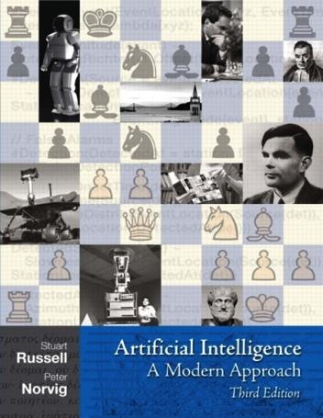
Textbook
Recommended
Russell & Norvig, AI: A Modern Approach

Slide 17
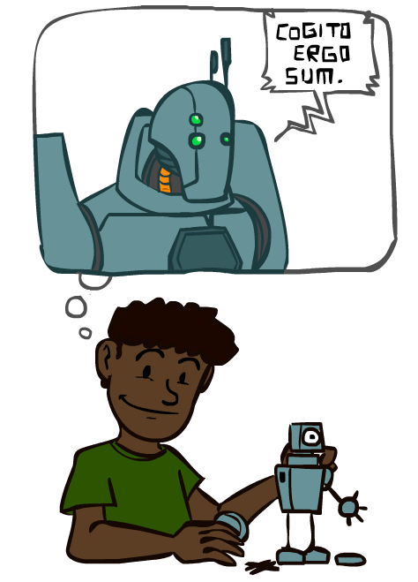
A (Short) History of AI

Slide 18
A (Short) History of AI
1940-1950: Early days
1943: McCulloch & Pitts: Boolean circuit model of brain
1950: Turing's “Computing Machinery and Intelligence”
1950—70: Excitement: Look, Ma, no hands!
1950s: Early AI programs, including Samuel's checkers program, Newell & Simon's Logic Theorist, Gelernter's Geometry Engine
1956: Dartmouth meeting: “Artificial Intelligence” adopted
1965: Robinson's complete algorithm for logical reasoning
1970—90: Knowledge-based approaches
1969—79: Early development of knowledge-based systems
1980—88: Expert systems industry booms
1988—93: Expert systems industry busts: “AI Winter”
1990—: Statistical approaches
Resurgence of probability, focus on uncertainty
General increase in technical depth
Agents and learning systems… “AI Spring”?
2000—: Where are we now?
Notes:
Computation with circuits, brain was like a bunch of circuits
Less computation than your watch; could barely do anything , but we thought we’re right there
Write stuff down, they start contradicting; winter
Statistics, uncertainty
Computation with artificial neurons, brain was like a bunch of real neurons ☺

Slide 19
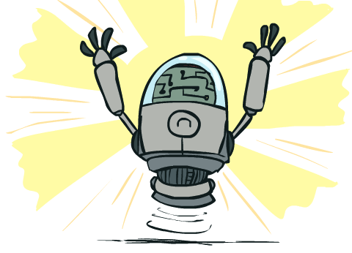
What Can AI Do?
Quiz: Which of the following can be done at present?
Play a decent game of Jeopardy?
Win against any human at chess?
Win against the best humans at Go?
Play a decent game of tennis?
Grab a particular cup and put it on a shelf?
Unload any dishwasher in any home?
Drive safely along the highway?
Drive safely along Telegraph Avenue?
Buy a week's worth of groceries on the web?
Buy a week's worth of groceries at Berkeley Bowl?
Discover and prove a new mathematical theorem?
Perform a surgical operation?
Unload a know dishwasher in collaboration with a person?
Translate spoken Chinese into spoken English in real time?
Write an intentionally funny story?

Slide 20
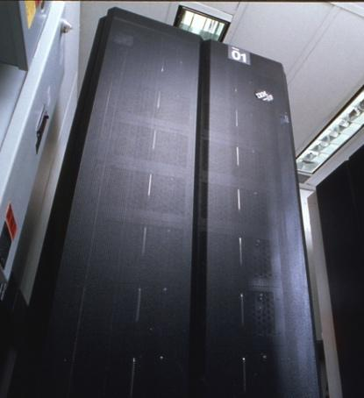
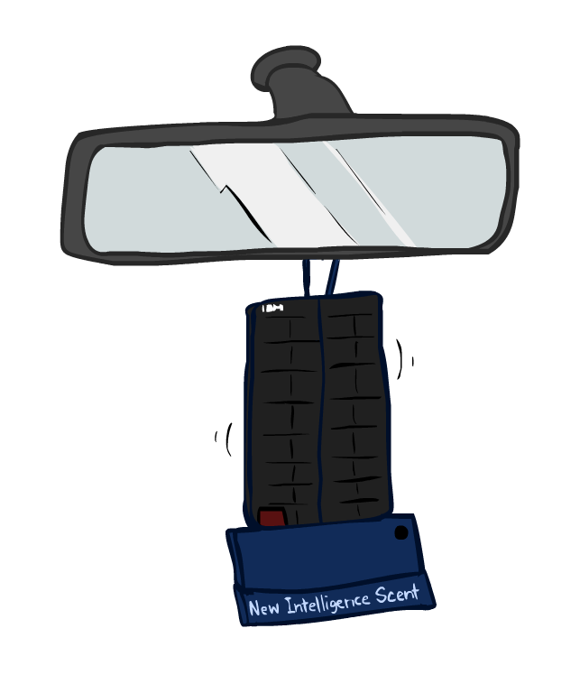
Game Agents
Classic Moment: May, '97: Deep Blue vs. Kasparov
First match won against world champion
“Intelligent creative” play
200 million board positions per second
Humans understood 99.9 of Deep Blue's moves
Can do about the same now with a PC cluster
1996: Kasparov Beats Deep Blue
“I could feel --- I could smell --- a new kind of intelligence across the table.”
1997: Deep Blue Beats Kasparov
“Deep Blue hasn't proven anything.”
Text from Bart Selman, image from IBM’s Deep Blue pages
Notes:
Yeah, Kasparov comment probably says more about humans than about computers

Slide 21

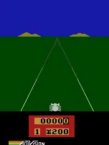
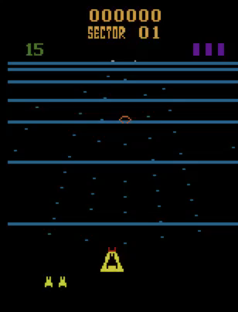
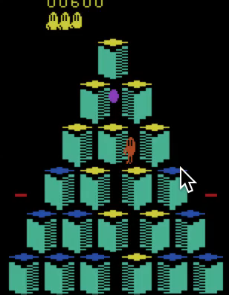
Game Agents
Reinforcement learning
Pong
Enduro
Beamrider
Q*bert

Slide 22
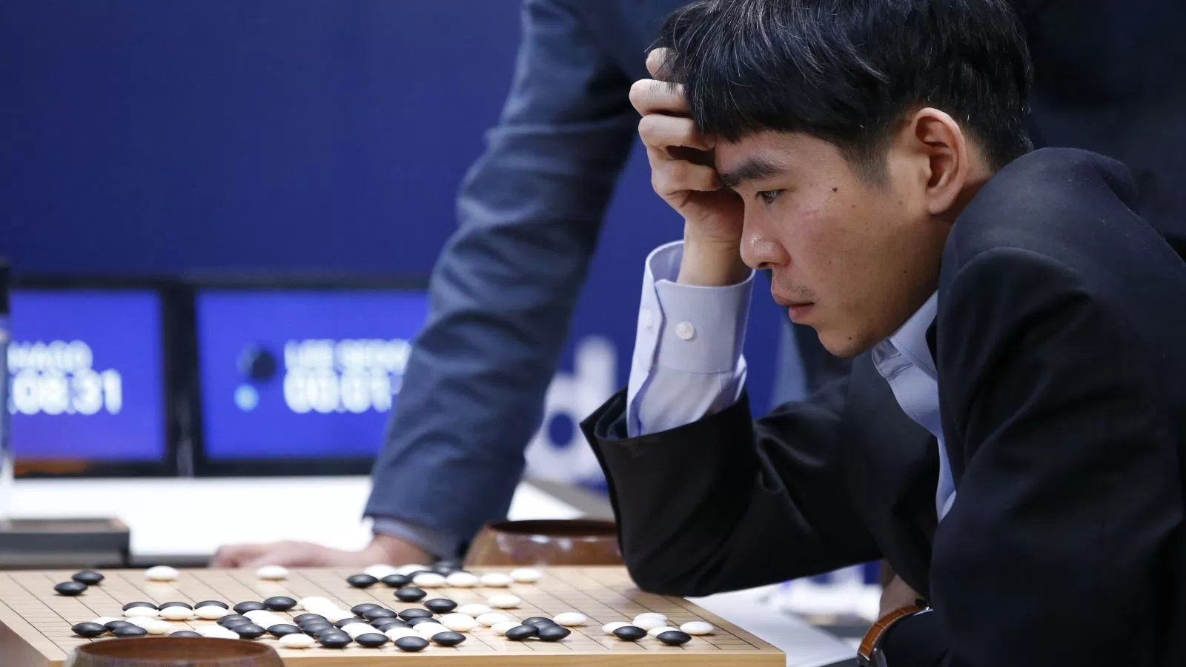
Game Agents
Reinforcement learning

Slide 23
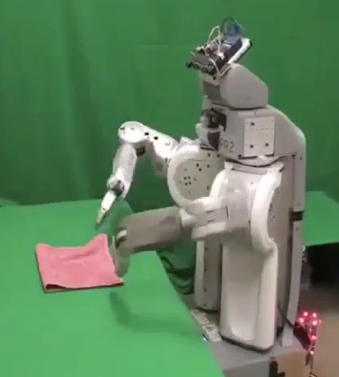
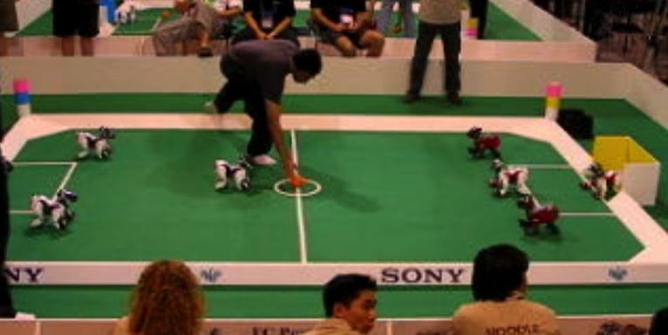
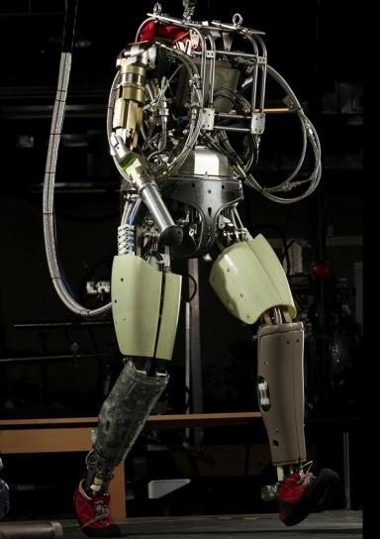
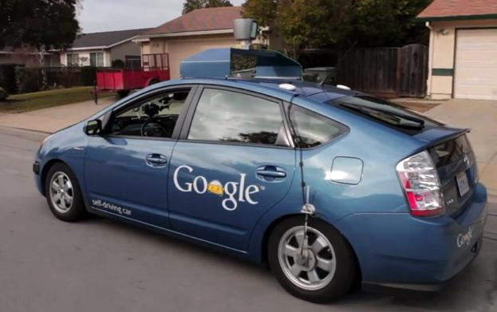
Robotics
Demo 1: ROBOTICS – soccer.avi
Demo 4: ROBOTICS – laundry.avi
Demo 2: ROBOTICS – soccer2.avi
Demo 5: ROBOTICS – petman.avi
Demo 3: ROBOTICS – gcar.avi
Robotics
Part mech. eng.
Part AI
Reality much
harder than
simulations!
Technologies
Vehicles
Rescue
Help in the home
Lots of automation…
In this class:
We ignore mechanical aspects
Methods for planning
Methods for control
Images from UC Berkeley, Boston Dynamics, RoboCup, Google

Slide 24
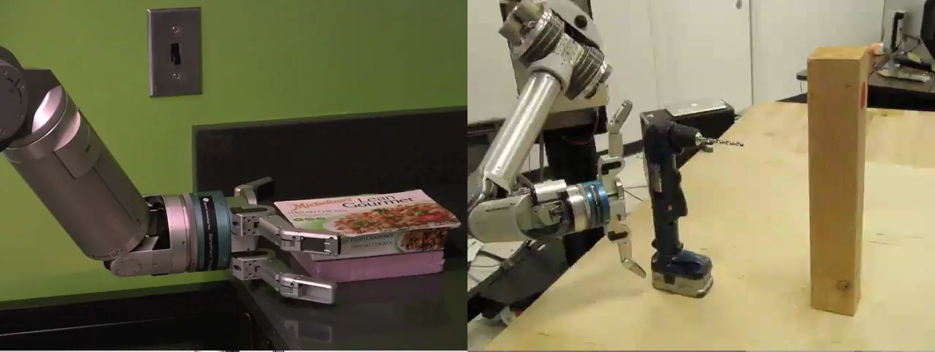
Robots

Slide 25
Robots
[Levine*, Finn*, Darrell, Abbeel, JMLR 2016]

Slide 26
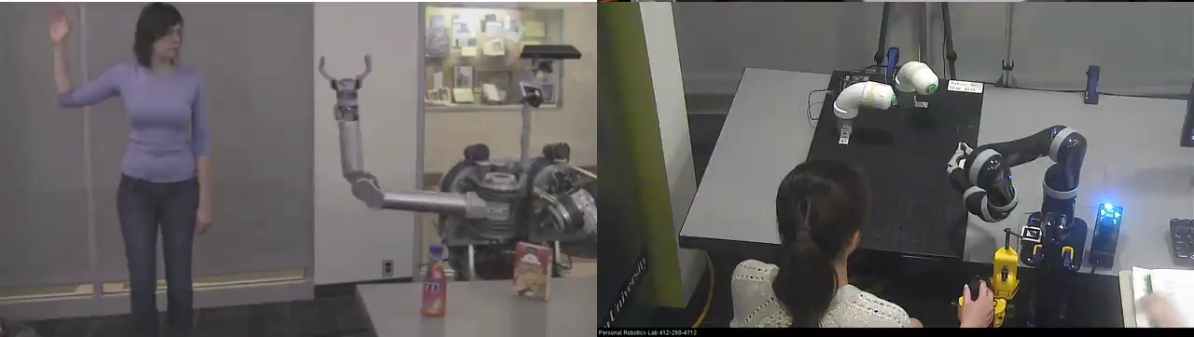
Human-AI Interaction

Slide 27
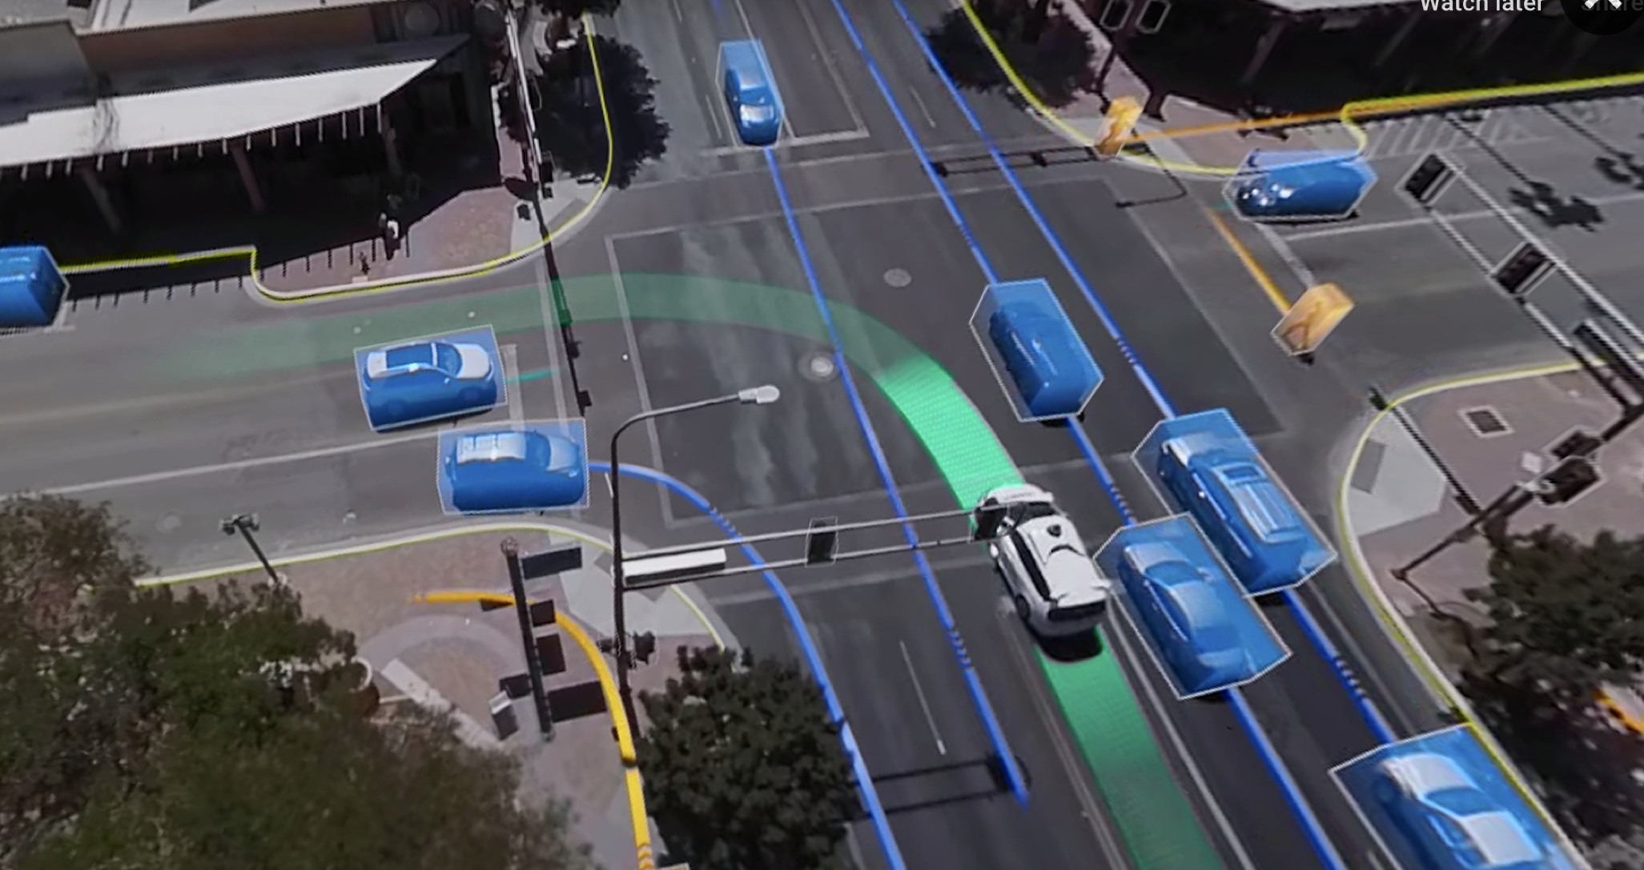

Slide 28




Slide 31
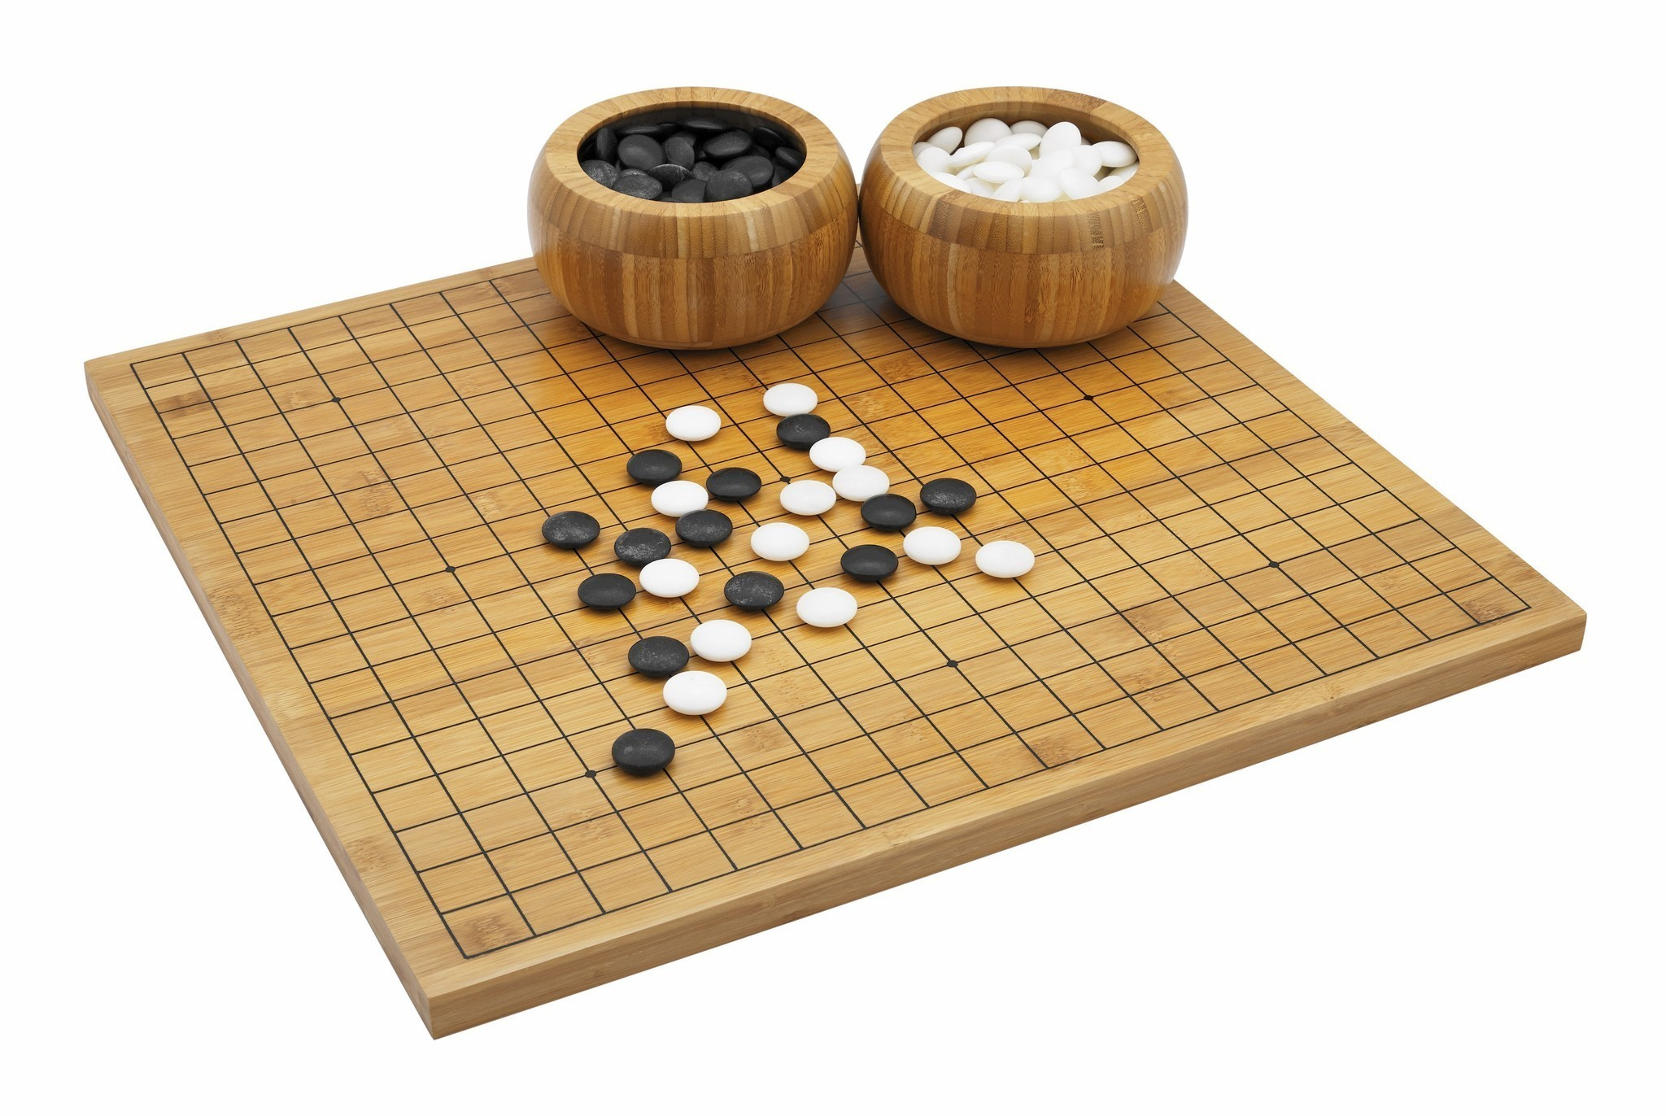
Utility?
Clear utility function
Not so clear utility function

Slide 32
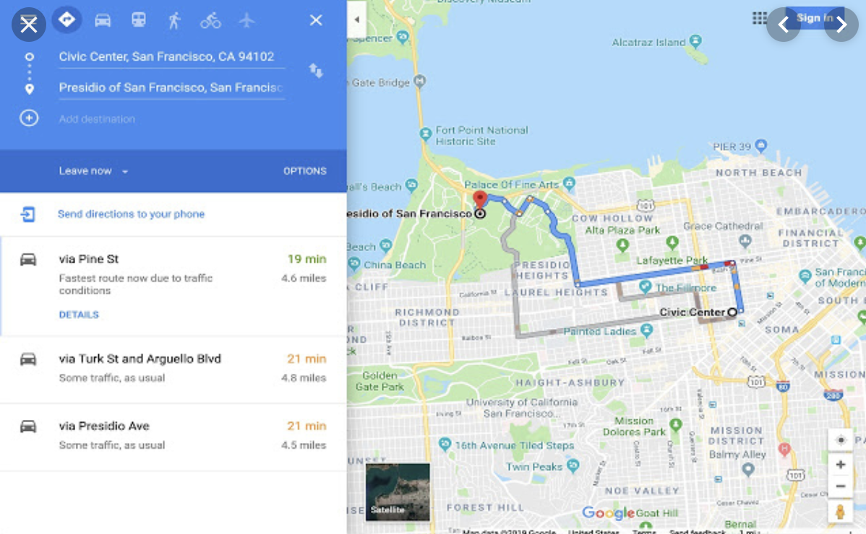
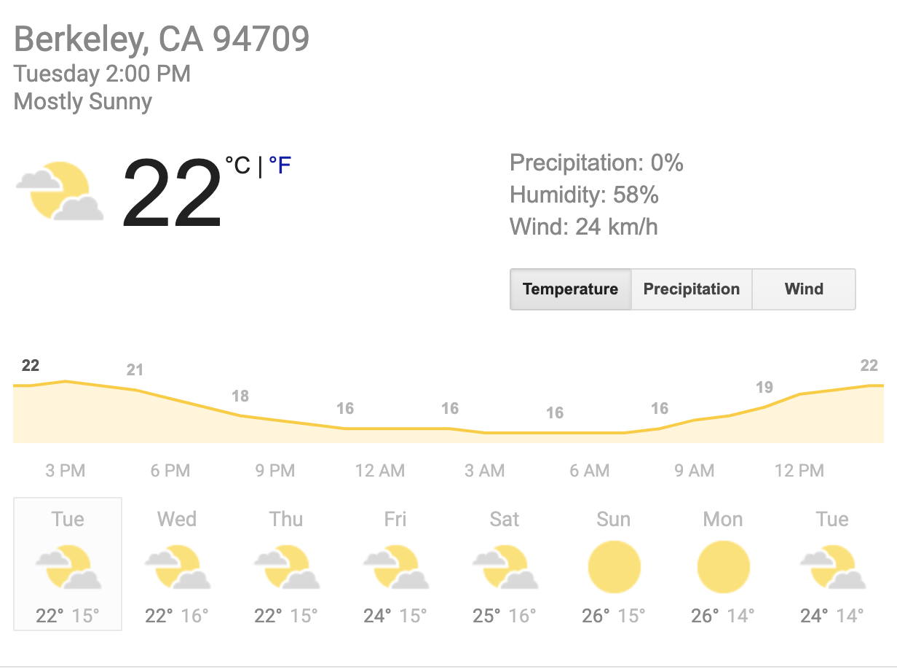
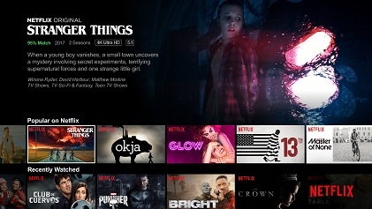

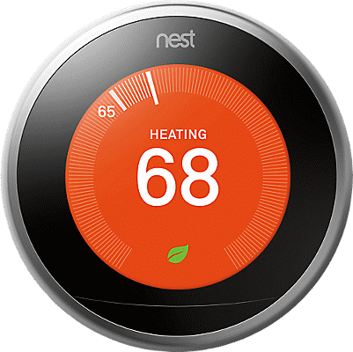

Tools for Predictions & Decisions

Slide 33
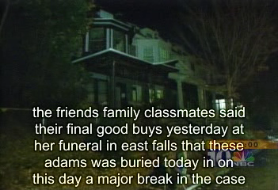
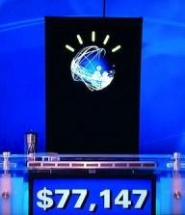
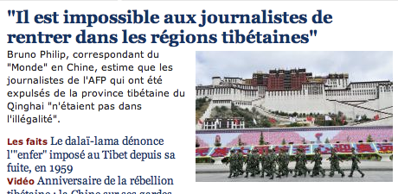
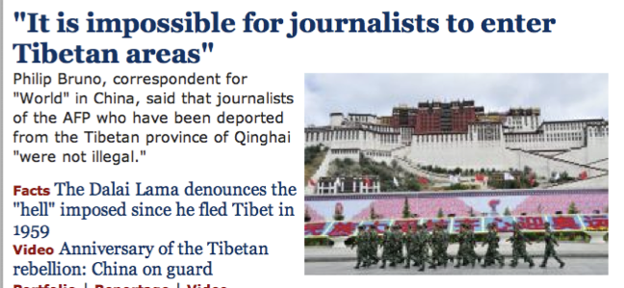
Natural Language
Speech technologies (e.g. Siri)
Automatic speech recognition (ASR)
Text-to-speech synthesis (TTS)
Dialog systems
Language processing technologies
Question answering
Machine translation
Web search
Text classification, spam filtering, etc…

Slide 34
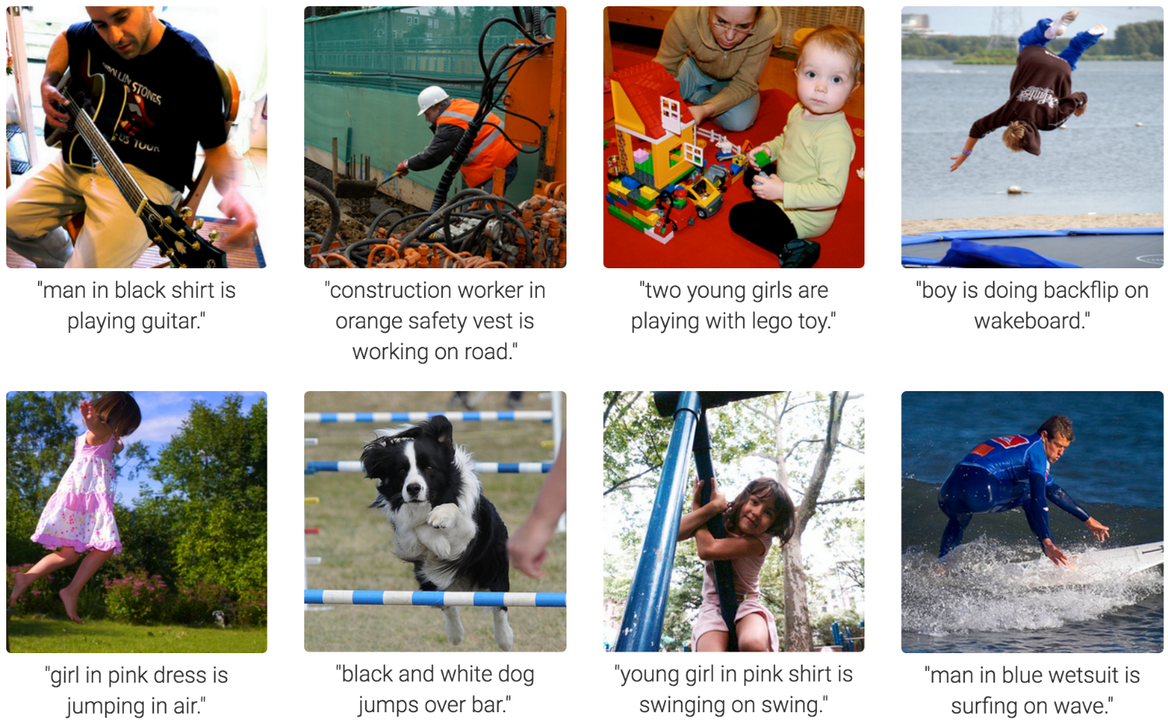
Computer Vision
Karpathy & Fei-Fei, 2015; Donahue et al., 2015; Xu et al, 2015; many more

Slide 35
Topics
Constraint satisfaction, e.g. scheduling
Search, planning, reinforcement learning, e.g. routing, robot navigation
Probabilistic inference, e.g. robot localization
A bit of supervised machine learning, e.g. spam detection

Slide 36
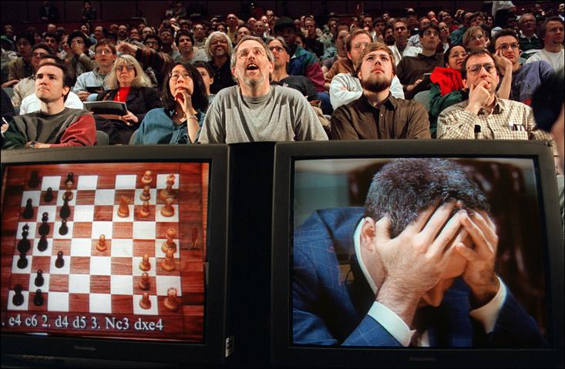
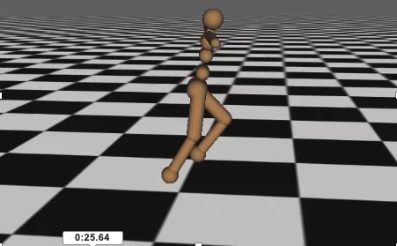

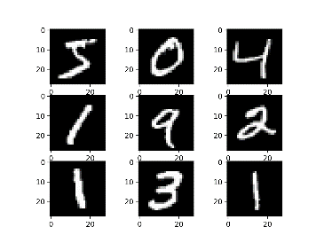
The kinds of AI problems
(*)briefly in our ML topic
(*) need continuous time versions

Slide 37
Thank You

